Slide 1
Comminution Energy Curves
Grant Ballantyne

Slide 2
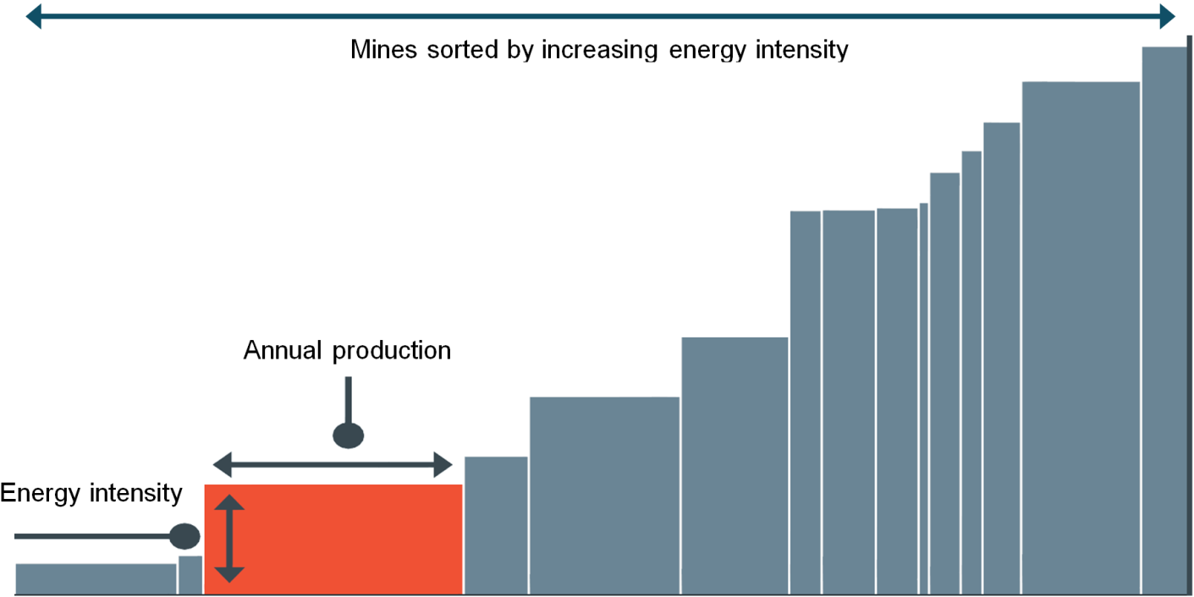
Energy benchmarking methodology (cost curve)
%

Slide 3
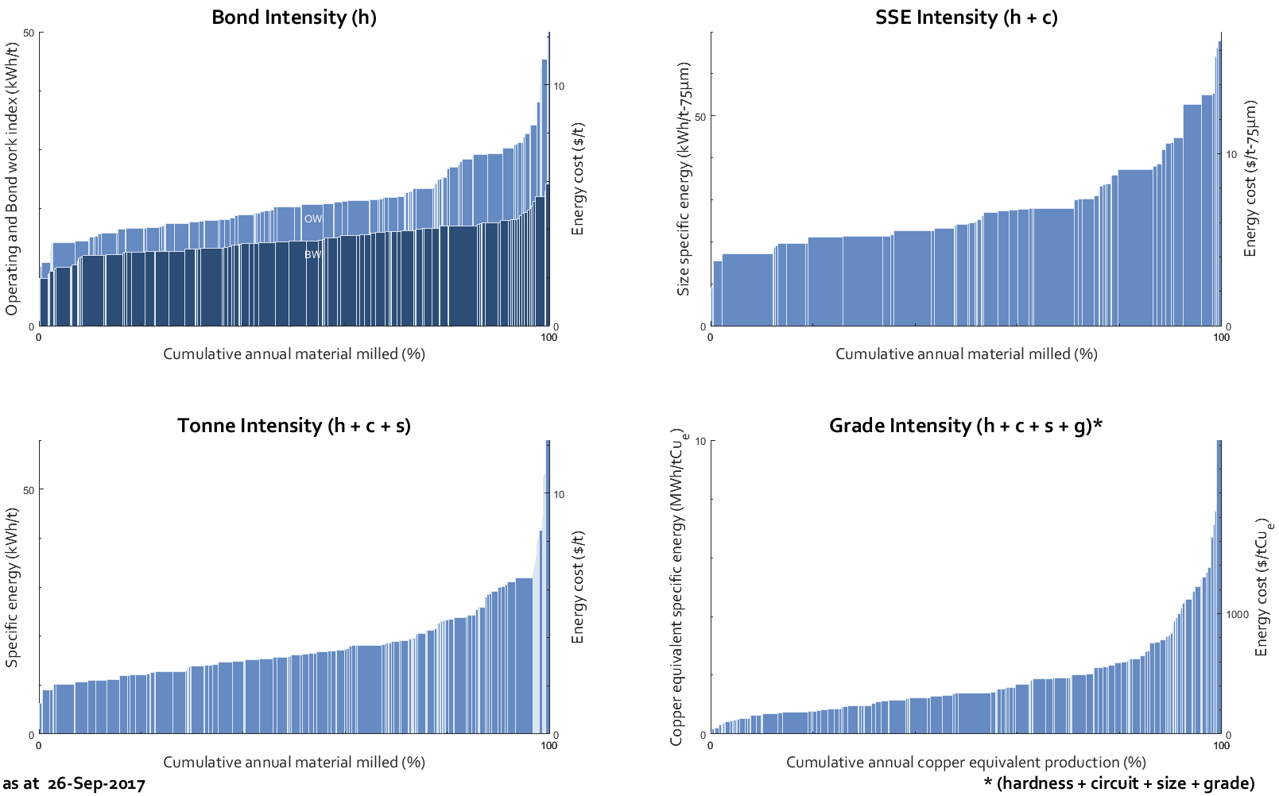
Suite of Comminution Energy Curves
Rock Hardness
Circuit Efficiency
Grind Size
Ore Grade

Slide 4
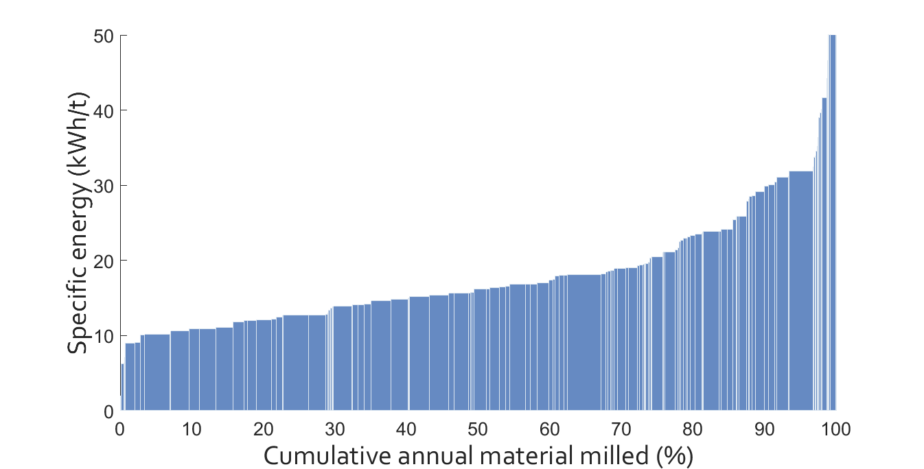
Case Studies: Mine to Mill
Kanchibotla, S.S., Vizcarra, T.G., Musunuri, S.A.R., Tello, S., Hayes, A., Moylan, T., 2015. Mine to mill optimisation at paddington gold operations, SAG Conference, Vancouver.

Slide 5
Size of the database ~ 700 datasets, 167 mines, 1.9 Bt/y

Slide 6
Next steps
Energy price variability model
METS Ignited project and workshops
Decarbonisation project with Dow Centre
Water Curves
Mine Energy Curves

