Slide 1
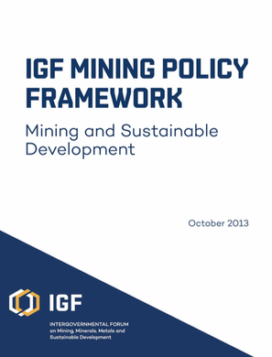
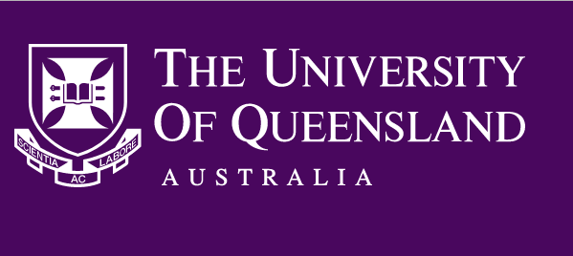
Governance and Organisation…integrated and innovative approaches towards sustainable development
How do we unlock mining’s contribution to sustainable development, throughout the mine life-cycle, and across the stakeholder spectrum?
FOCUS
Factoring SD into policy frameworks in government and industry | Effective approaches to multi-stakeholder governance | Designing organisations to better enable responsible decision-making
Understanding and accounting for resource value across the life of a mine
Implementing game-changing multi-stakeholder governance processes
Designing organisations to manage knowledge across the lifecycle
RESEARCH
Accounting for positive development outcomes across the life of a mine
Integrated and multi-disciplinary policy and governance frameworks for mine closure
Participatory water monitoring at the catchment and regional level
Sustainable Minerals Institute and EAIT | Centre for Policy Futures, Political Science | School of Earth and Environmental Sciences | T.C. Beirne School of Law
School of Social Science | Institute for Social Science Research | UQ Business School | ICTE inc. UQ International Development
LINKAGES
Notes:
Organising within companies and across the stakeholder spectrum.
Beyond government to governance and collaborative approaches.
A focus on value creation – sustainable and equitable outcomes.

