Slide 1
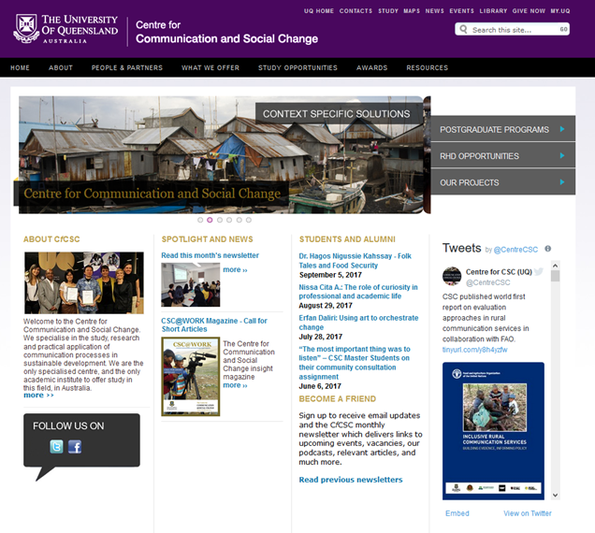
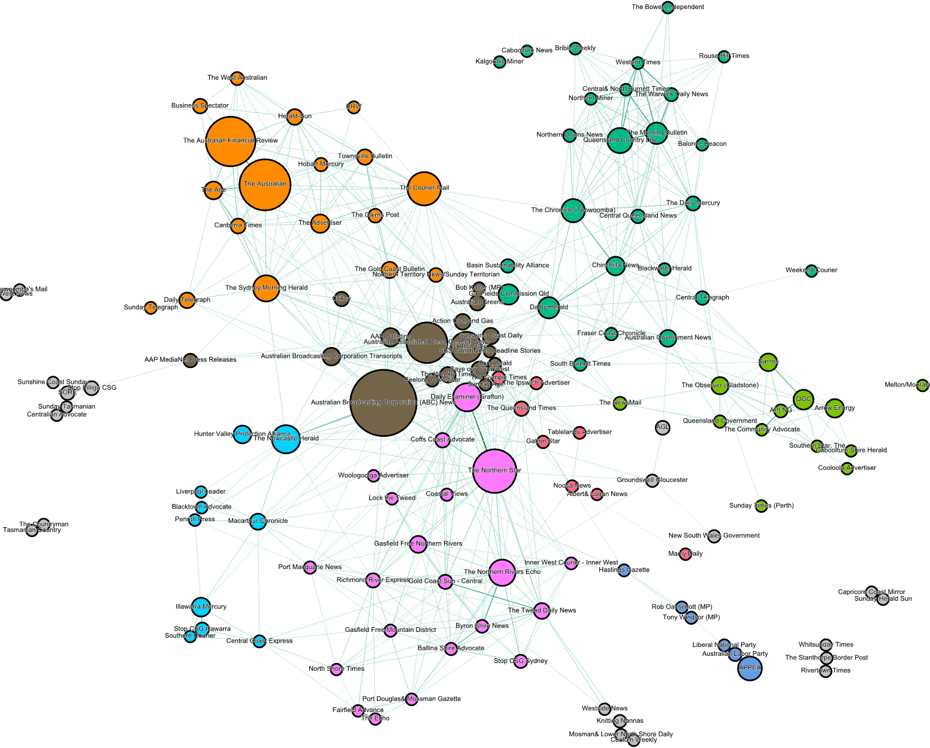
School of Communication and Arts
Research & application of communication processes in sustainable development
Understanding social & psychological drivers of community responses to mining
Applying computational analytics to understand public discourse
Example project
How is the mining industry influencing rural development and livelihoods in Mongolia?
Documentary film made about this dilemma to feed into policy discussions & training of rural development facilitators
Example project
Will people accept unconventional forms of mining & why/why not?
27 nation survey (N = 4819) showed support for off-earth mining compared to on-earth mining.
Examples projects
Evaluating public discourse about CSG in Australia
Communicating scientific knowledge about CCS through social media

