Slide 1
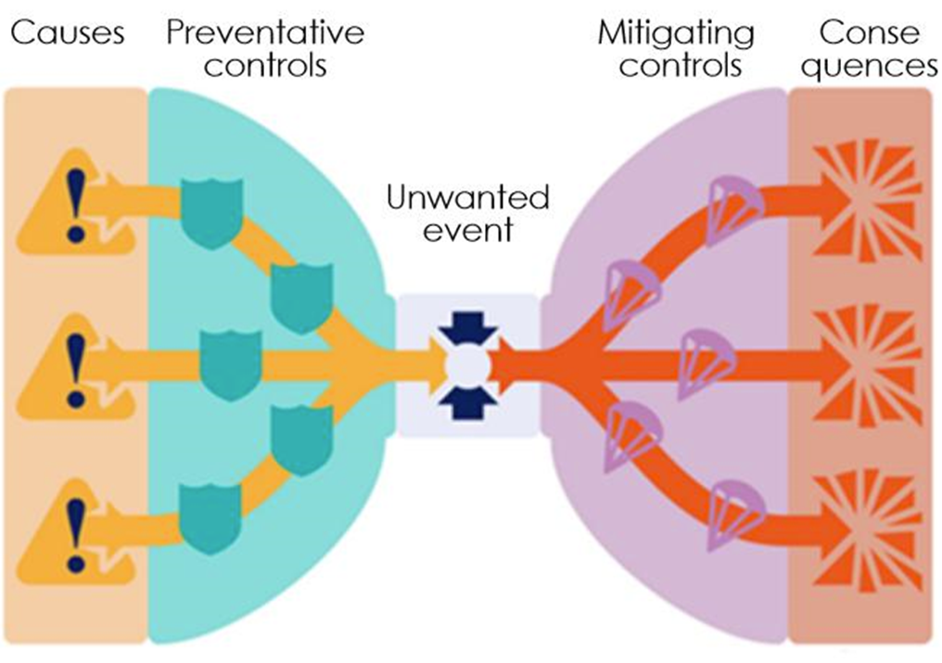
Extending risk-based methods to the management of miners’ health and well-being
Safety
WHS: Health “the poor cousin” of safety
Not as visible
Time
Multifactorial
Individual factors
Health

