Slide 1
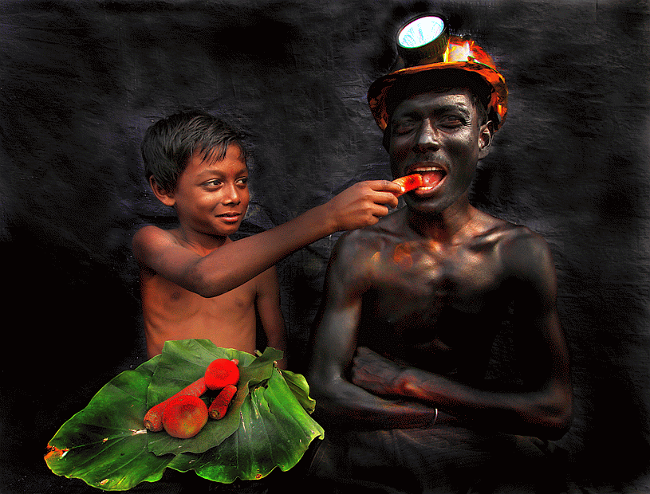
Mining, livelihoods, food security: joining some dots Grace Muriuki (PhD)
Resettlements consortium.
Livelihoods and Food Security*.
Urbanization – transforming relationships, rural/urban.
Cascading impacts - water, food, energy, infrastructure, power.
Legacies & Entanglements.
Nested vulnerabilities.
Space, location, hierarchy.
Focus on systems.
Smart Cities, Land use, curriculum
Donor space: ACIAR, Gates, ARC.
GCI, BEL, IMB, SPH, SEES, SAFS
Credits: Supriya Biswas/GCI July 2017

