Slide 1
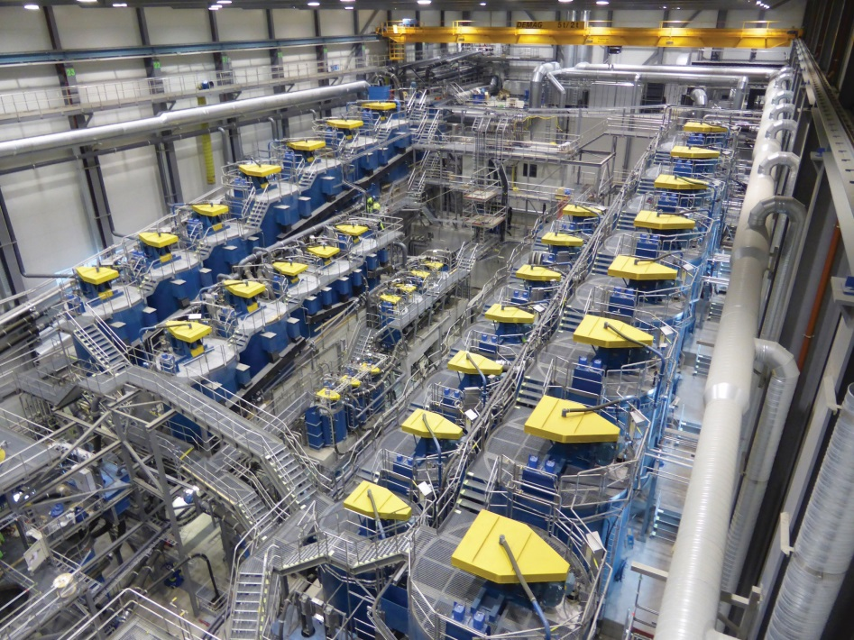
Separation Research Program
  “Separation” aims to
  develop novel or improve separation processes to achieve step change for industry
  develop models to accelerate technology adoption
Separation consists of six researchers with experience in flotation, mineralogy, comminution, microwave processing and ore preconcentration

Slide 2
The Traditional Separation Route
Highly Energy Intensive
High Water Usage
Limitation of Throughput
Inflexible Processing
Route
Tailings
Environmental
Problems
Incomplete Recovery
Unwanted impurities
In concentrate

Slide 3
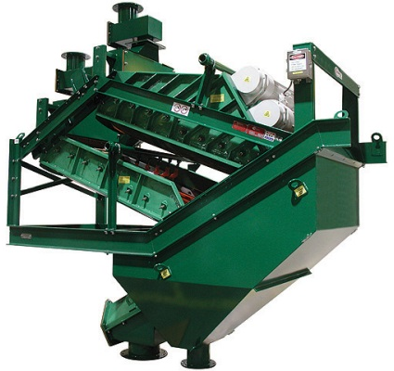
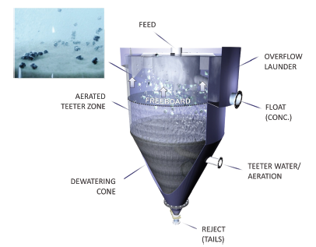
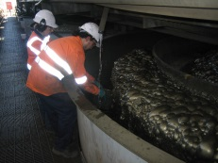
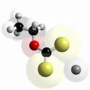
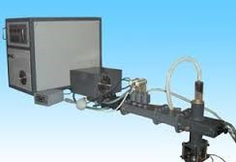
Current Research Focus
Improved Classification
Less Energy
Higher Recoveries
High Voltage Pulse Comminution
Preconcentration
Higher Recoveries
Coarse Particle Flotation
Less energy
Higher recoveries
Flotation Optimisation Strategies
Less Energy
Higher recoveries
Less impurities
New Reagents
Less impurities in concentrate
Microwave Dewatering Tailings
Less Water, Reprocessing

