Slide 1
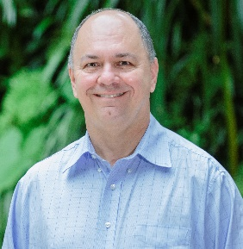
Dr. Carlos Spier
Industry Experience
My Life in Academia
Research Activities
Professional geologist 30⁺ years in the mining industry
Worked for large organizations (Vale and BHP) and junior companies
Extensive experience in exploration and technical services roles
Open pit and underground experience
Several mineral commodities (Mn, Cr, Ni, Fe, Mineral Sands)
PhD Geology/Geochemistry and MSc in Mineral Economics
Moved to UQ in April 2016
Lecturer at SEES:
Ore Body Modelling
Exploration Geochemistry
Ore Deposits
Limited to short term projects due to contractor position: Honours and MSc projects
Current projects:
Distribution of P in iron ore
Control mechanism of Pt and Ni mineralization
Mineralogical studies on IOCGs project in Mount Isa
Interest in economic geology, ore characterization and geometallurgy
High demand from students to supervise projects
Contact
Phone: [07 3346 4134]
Email: c.spier@uq.edu.au

